Slide 1
Kai Hwang: Cloud Computing for Machine Learning and Cognitive Applications The MIT Press, Cambridge, MA. 2017 Chapter 8: MapReduce Paradigm, Hadoop and Spark Programming (96 slides for 6 - hour lectures) All rights reserved by Kai Hwang and MIT Press, 2017. For exclusive use by qualified instructors adopting the textbook, not for commercial or publication release

Slide 2
The Evolution of Scalable Parallel Computing From MapReduce to Hadoop and Spark in the last 10 years
Google MapReduce Paradigm Written in C: from Search Engine to Google AppEngine
Hadoop Library for MapReduce Programming in Java environments
Extending Hadoop from MapReduce in Batch Processing Mode using distributed disks to Spark for In-Memory Processing in Streaming Mode over any DAG computing Paradigm

Slide 3
MapReduce: Scalable Data Processing on Large Clusters
A web programming model for fast processing large datasets
Applied in web-scale search and cloud computing applications
Users specify a map function to generate intermediate key/value pairs
Users use a reduce function to merge all intermediate values with the same key

Slide 4
Batch Processing MapReduce
Map: applies a programmer-supplied map function to each input data split (block)
Runs on thousands of computers
Provides new set of key-value pairs as intermediate values
Reduce: collapses values using another programmer-supplied function, called reduction, such as Max., Min, Average, dot product of two vectors, …….
Notes:
The University of Adelaide, School of Computer Science
15 September 2017
Chapter 2 — Instructions: Language of the Computer
4

Slide 5
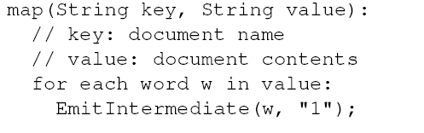
Example: Counting the number of occurrences of each word in a large collection of documents
The map function emits each word w plus an associated count of occurrences (just a “1” is recorded in this pseudo-code)

Slide 6
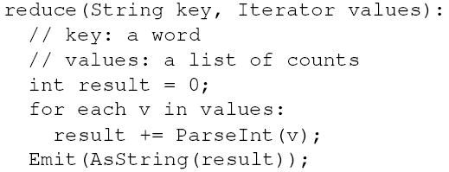
Example: Counting the number of occurrences of each word in a large collection of documents
The reduce function sums together all counts emitted for a particular word

Slide 7
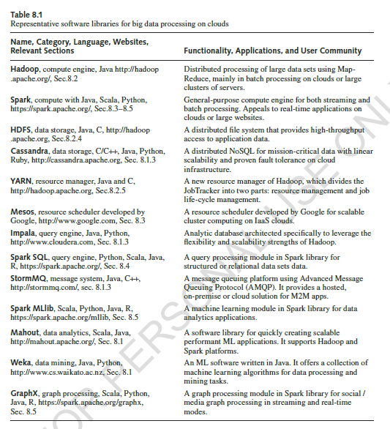

Slide 9
Notes:
Cloud applications are the key global opportunity for developers during next four years
2009: $8.5 billion
2013: $16.8 billion

Slide 10
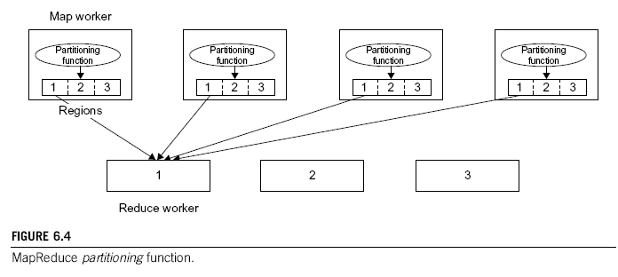
Linking the Map Workers and Reduce Workers by Key Matching in Partitioning Functions
Notes:
Cloud applications are the key global opportunity for developers during next four years
2009: $8.5 billion
2013: $16.8 billion

Slide 11
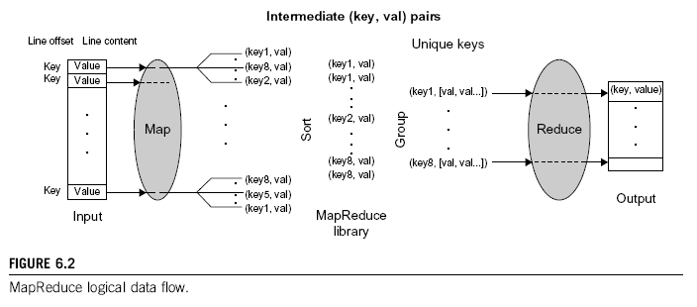
Logical Data Flow in 5 Processing Steps in MapReduce Process
(Key, Value) Pairs are generated by the Map function over multiple available Map Workers (VM instances). These pairs are then sorted and group based on key ordering. Different key-groups are then processed by multiple Reduce Workers in parallel.
Notes:
Cloud applications are the key global opportunity for developers during next four years
2009: $8.5 billion
2013: $16.8 billion

Slide 12
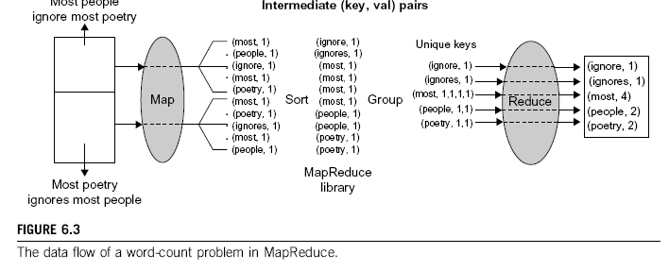
A Word Counting Example on <Key, Count> Distribution
Notes:
Cloud applications are the key global opportunity for developers during next four years
2009: $8.5 billion
2013: $16.8 billion

Slide 13
Fig.6.5 Dataflow Implementation
of MapReduce
Notes:
Cloud applications are the key global opportunity for developers during next four years
2009: $8.5 billion
2013: $16.8 billion

Slide 14
Example: Distributed Grep
Map function: - input is (file offset, line) - output is either:
1. an empty list // (the line does not match) 2. a key-value pair // (line, 1)] (if it matches) Reduce function: - input is (line, [1, 1, 1, ...]) - output is (line, n) where n is the sum of 1s in the list.

Slide 15
Distributed Grep
C
B
B
C
File 1
File 2
Result
C
A
3 C
1 A
Map tasks: (0, C) -> [(C, 1)] (2, B) -> [] (4, B) -> [] (6, C) -> [(C, 1)] (0, C) -> [(C, 1)] (2, A) -> [(A, 1)]
Reduce tasks: (A, [1]) -> (A, 1)
(C, [1, 1, 1]) -> (C, 3)

Slide 16
MapReduce for Parallel Matrix Multiplication

Slide 17
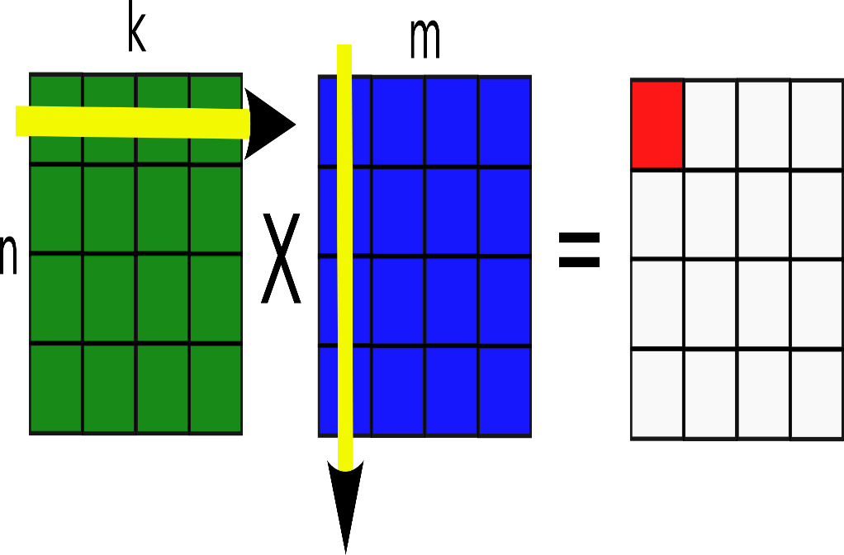
Parallel Matrix Multiplication
Consider the Matrix Multiplication with A[NxK] * B[KxM] = C[NxM]
To compute C_{ij} we need to use the row vector "i" of matrix A and the row vector "j" of transpose of matrix B
Dot product of the 2 row vectors gives the element C_{ij}
Parallelize for different elements of C

Slide 18
Hadoop Matrix Multiplication
Mapper creates multiple [Key, Value] pairs where
Key is C_{ij}
Value is the "i"th row vector of A or "j"th row vector of Transpose(B)
Reducer finds the element C_{ij} by
Collecting all values with Key C_{ij} (Here there will be 2 [Key, Value] pairs with C_{ij}. Why?)
Performing dot product of the row vectors
Assuming 2 Square Matrices with dimensions [NxN], each element of the resultant Matrix needs N x N computations. Total Complexity = N * N² = N³ operations. If N² processors are used to do computation in Parallel, theoretically a speedup of O(N² ⁾ is possible.

Slide 19
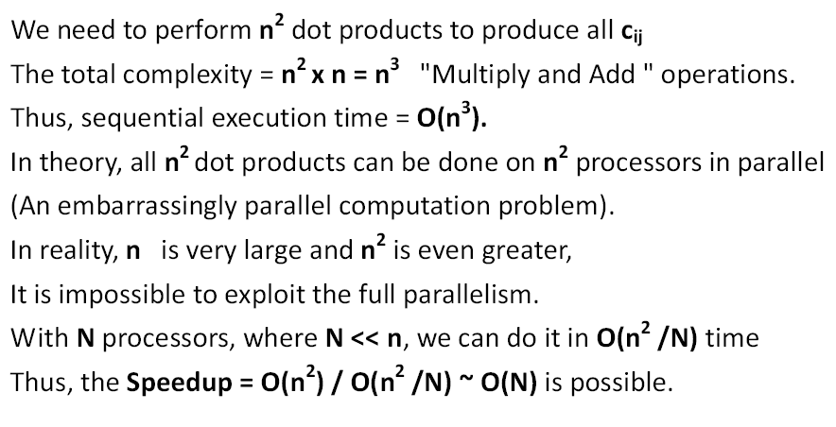
Computational Complexity Analysis
Notes:
Cloud applications are the key global opportunity for developers during next four years
2009: $8.5 billion
2013: $16.8 billion

Slide 20
When n is very large, everything becomes not so easy to do (1)
Reading and storing a large number of input and output matrix elements demands excessive I/O time and memory space
Data reference locality demands many duplications of the row and column vectors to local processors – The Map functions in MapReduce model
Dot products can be done on the Reduce Nodes in parallel blocks identified by the same set of “keys”
Notes:
Cloud applications are the key global opportunity for developers during next four years
2009: $8.5 billion
2013: $16.8 billion

Slide 21
Parallel Matrix Multiplication (2)
If you use 128 VM instances, you should expect an ideal speedup of 128 over the use of a single VM. In your AWS account, you are allowed up to 20 VM instances. Using more than 20, you need to get special permission from the AWS management
Use Map servers to distribute the partitioned data blocks. Use the Reduce servers to produce many dot products in blocks. The task forks out from the master server to all available Map and Reduce servers (workers) may result in additional scheduling overhead
Demand large-scale shuffle and exchange sorting and grouping operations over all intermediate <key, value> pairs , externally in and out of disks
Use a random number generator to generate the 32-bit floating point numbers as input sets for matrices A and B

Slide 22
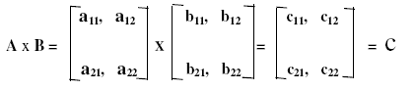
A Small Example
c11 = a11 x b11 + a12 x b21 c12 = a11 x b12 + a12 x b22
c21 = a21 x b11 + a22 x b21 c22 = a21 x b12 + a22 x b22
Map the first row of matrix A and entire matrix B to a Map Server 1
Map the second row of matrix A and entire matrix B to a Map Server 2
Four keys are used to identify 4 blocks of data processed
Notes:
Cloud applications are the key global opportunity for developers during next four years
2009: $8.5 billion
2013: $16.8 billion

Slide 23
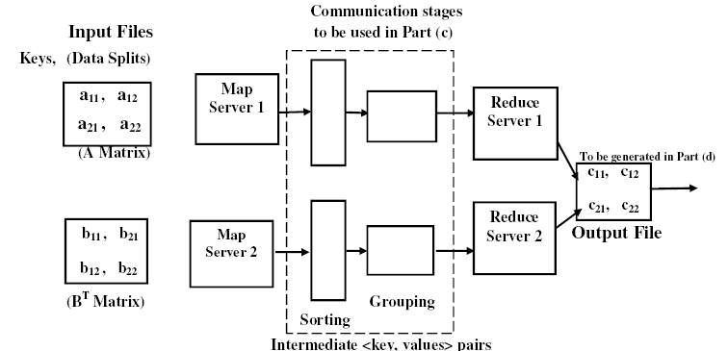
K1
K2
K3
K4
Notes:
Cloud applications are the key global opportunity for developers during next four years
2009: $8.5 billion
2013: $16.8 billion

Slide 24
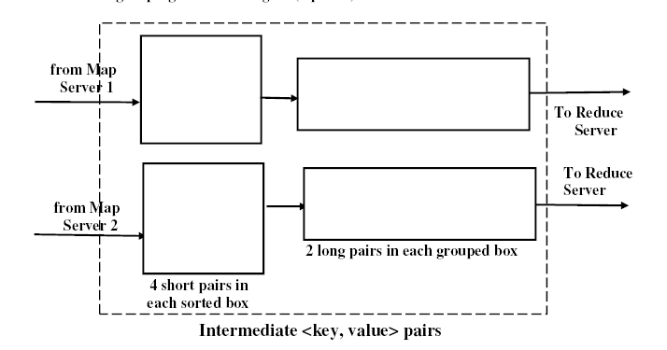
<K1, a11 x b11>
<K1, a12 x b11>
< K1; a11 x b11, a12 x b21 >
<K2, a11 x b12>
< K2; a11 x b12, a12 x b22 >
<K1, a12 x b22>
1
<K3, a21 x b11>
< K3; a21 x b11, a22 x b21 >
2
<K3, a22 x b21>
<K4, a21 x b12>
< K4; a21 x b12, a22 x b22 >
<K4, a22 x b22>
The Reduce Servers do the Summation to produce the (cij) elements
Notes:
Cloud applications are the key global opportunity for developers during next four years
2009: $8.5 billion
2013: $16.8 billion

Slide 25
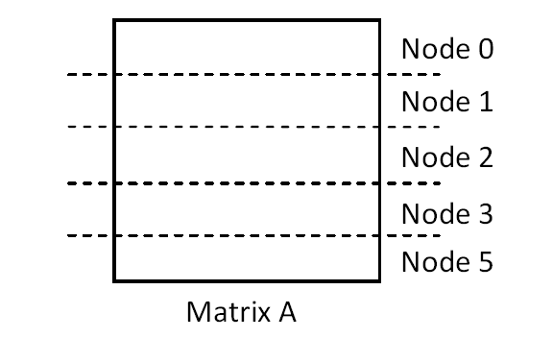
Input Matrix Partitioning
By row vectors of matrix A and by column vectors of matrix B or by row vector of the transposed matrix B^{T}
32-bit floating-point numbers by IEEE 754-1985 standard, we have to handle 2 x 512 x 512 = 2¹⁹ such signed FLP numbers from matrices A and B
Notes:
Cloud applications are the key global opportunity for developers during next four years
2009: $8.5 billion
2013: $16.8 billion

Slide 26
The Input Files partitioned into Blocks identified by Keys with Values in L (left) or R (right) Matrices
Notes:
Cloud applications are the key global opportunity for developers during next four years
2009: $8.5 billion
2013: $16.8 billion

Slide 27
Python Code Solution: An Example
Input Files for left Matrix A and right Matrix B
Notes:
Cloud applications are the key global opportunity for developers during next four years
2009: $8.5 billion
2013: $16.8 billion

Slide 28
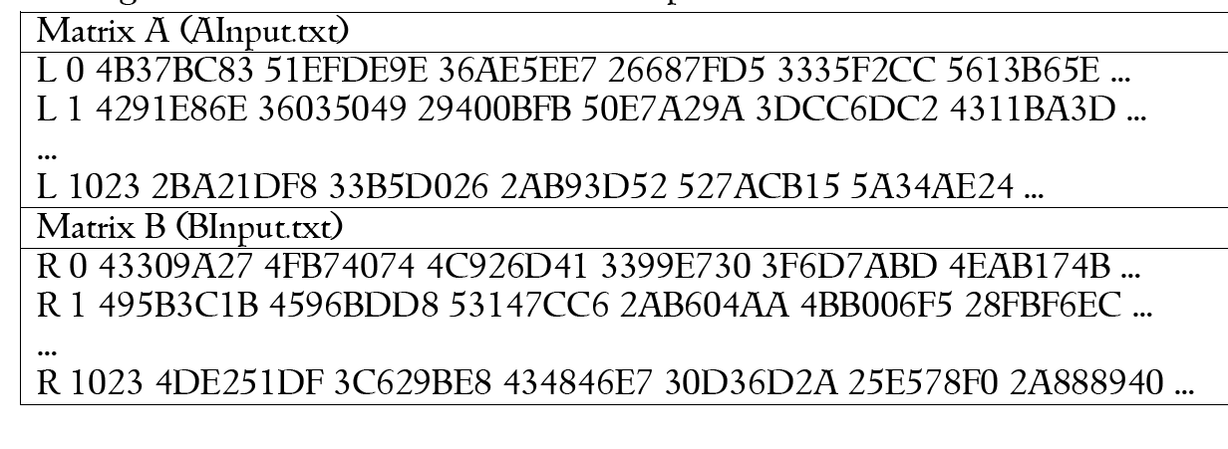
Input Files for left Matrix A and right Matrix B
Notes:
Cloud applications are the key global opportunity for developers during next four years
2009: $8.5 billion
2013: $16.8 billion

Slide 29
The Output File for Matrix C
Notes:
Cloud applications are the key global opportunity for developers during next four years
2009: $8.5 billion
2013: $16.8 billion

Slide 30
Dot Product Parallelization into blocks affects the reduce speed and the efficiency in the computation of the entire MapReduce process.
Matrix C
Notes:
Cloud applications are the key global opportunity for developers during next four years
2009: $8.5 billion
2013: $16.8 billion

Slide 31
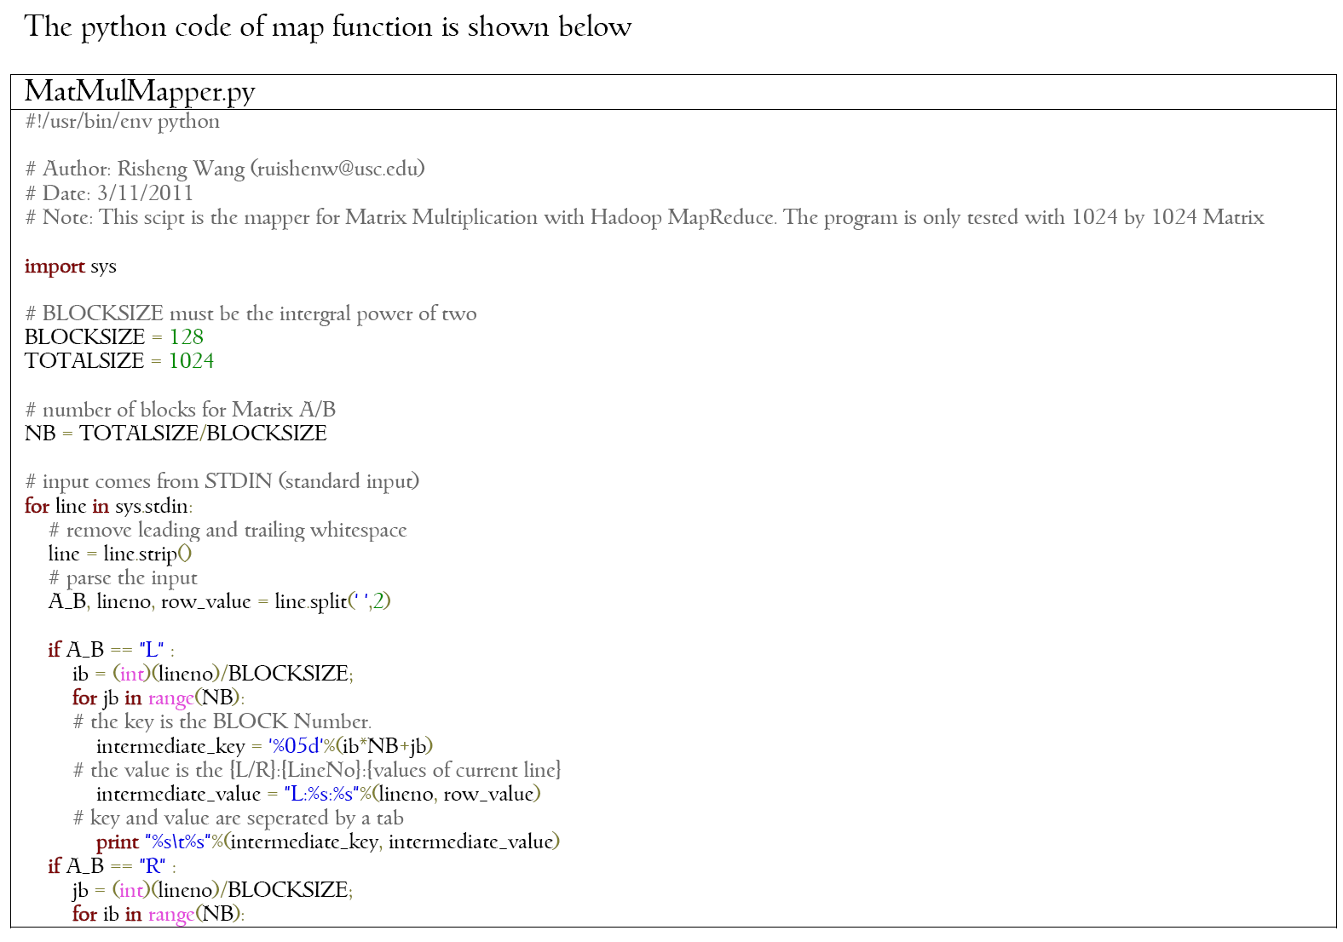
NB = No. of blocks in each row (or in each transposed column)
Notes:
Cloud applications are the key global opportunity for developers during next four years
2009: $8.5 billion
2013: $16.8 billion

Slide 32
ib = row index of each block
jb = column index of the block
NB = No. of blocks in each row
Notes:
Cloud applications are the key global opportunity for developers during next four years
2009: $8.5 billion
2013: $16.8 billion

Slide 33
Notes:
Cloud applications are the key global opportunity for developers during next four years
2009: $8.5 billion
2013: $16.8 billion

Slide 34
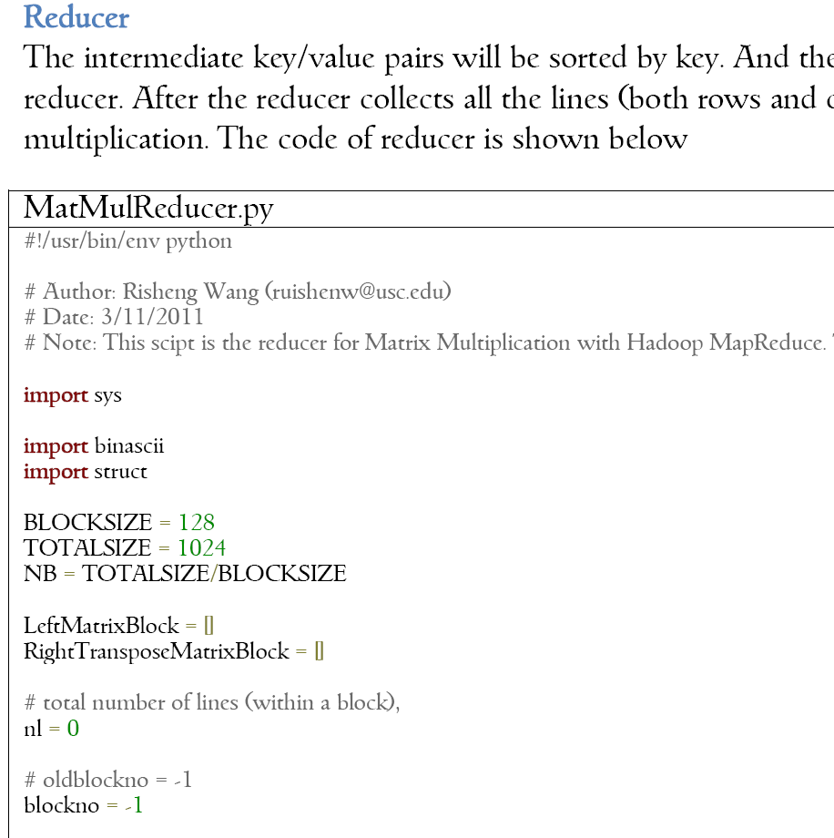
Notes:
Cloud applications are the key global opportunity for developers during next four years
2009: $8.5 billion
2013: $16.8 billion

Slide 35
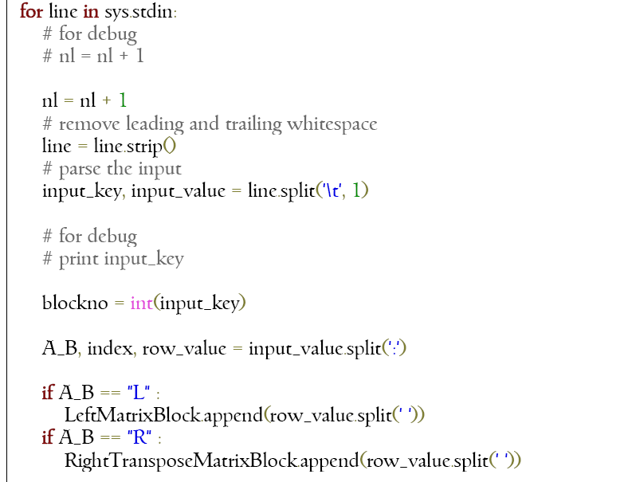
Notes:
Cloud applications are the key global opportunity for developers during next four years
2009: $8.5 billion
2013: $16.8 billion

Slide 36
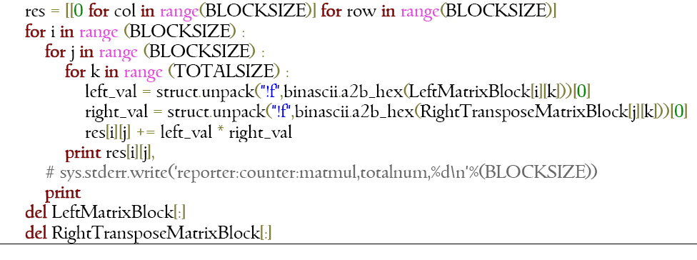
Multiply-and-Add (dot product)
Notes:
Cloud applications are the key global opportunity for developers during next four years
2009: $8.5 billion
2013: $16.8 billion

Slide 37
A submatrix (128x128) for each of 64 = 8x8 blocks, if the block size is 128 elements
Notes:
Cloud applications are the key global opportunity for developers during next four years
2009: $8.5 billion
2013: $16.8 billion

Slide 38
Notes:
Cloud applications are the key global opportunity for developers during next four years
2009: $8.5 billion
2013: $16.8 billion

Slide 39
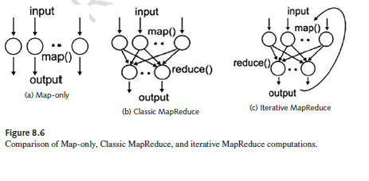
Notes:
Cloud applications are the key global opportunity for developers during next four years
2009: $8.5 billion
2013: $16.8 billion

Slide 40
Hadoop: A software platform originally developed by a Yahoo! group to enable users write and run applications over distributed data
Scalable: can easily scale to store and process petabytes of data in the Web space
Economical: An open-source MapReduce minimizes the overheads in task spawning and massive data communication
Efficient: Processing data with high-degree of parallelism across a large number of commodity nodes
Reliable: Automatically maintains multiple copies of data to facilitate redeployment of computing tasks on failures

Slide 41
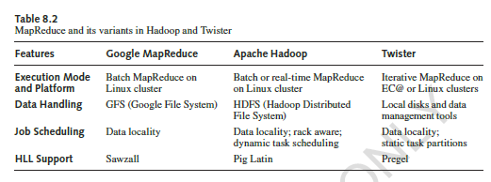
Notes:
Cloud applications are the key global opportunity for developers during next four years
2009: $8.5 billion
2013: $16.8 billion

Slide 42
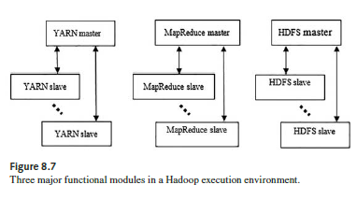
High-Level Hadoop Master-Slave Architecture: The Yarn Scheduler, MapReduce and HDFS

Slide 43
Building Blocks in Apache Hadoop
Hadoop Common: The common utilities that support the other Hadoop modules
Hadoop Distributed File Syste, (HDFS): A distributed file system that provides high-throughput access to application data
Hadoop YARN: A framework for job scheduling and cluster resource management
Hadoop MapReduce: A yarn-based system for parallel processing of large data sets

Slide 44
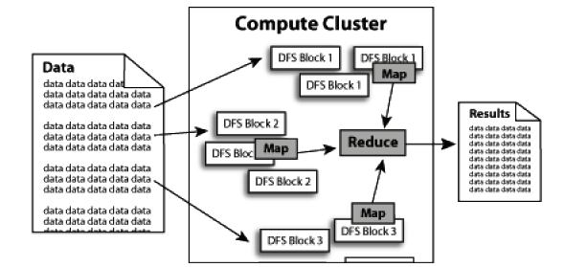
Apache Hadoop Architecture
DFS: Hadoop Distributed File System

Slide 45
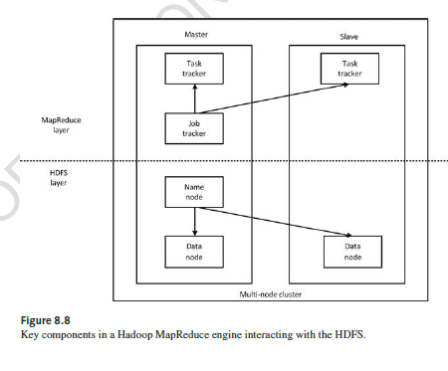
An HDFS Client Communicating with the Master NameNode and Slave DataNode

Slide 46
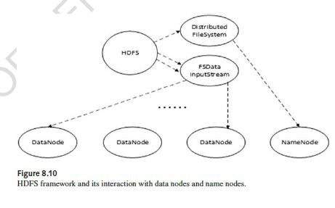
Notes:
Cloud applications are the key global opportunity for developers during next four years
2009: $8.5 billion
2013: $16.8 billion

Slide 47
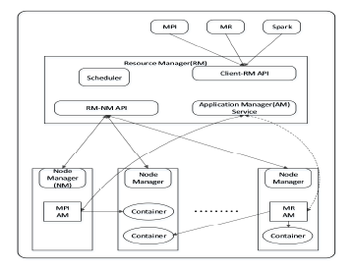
Distributed
Parallel Computa-tion on
Hadoop
Interacting with MPI, MR, and Spark Programm-ing Eiviron-ment
Notes:
Cloud applications are the key global opportunity for developers during next four years
2009: $8.5 billion
2013: $16.8 billion

Slide 48
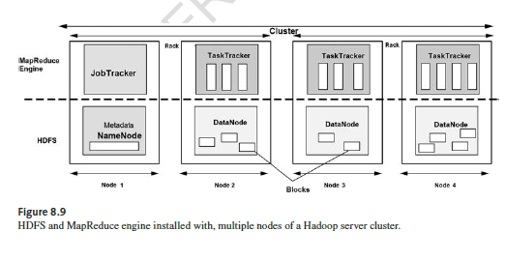
Notes:
Cloud applications are the key global opportunity for developers during next four years
2009: $8.5 billion
2013: $16.8 billion

Slide 49
DNA Sequence Analysis on Cloud
Sequence alignment --- a way to identify regions of similarity that may be a consequence of functional, structural or evolutionary relationships between sequences. A multiple sequence alignment is a sequence alignment of three or more biological sequences, generally protein, DNA, or RNA
Current methods use Dynamic Programming which is computationally intense or progressive methods closest sequence first and then add more distant sequences. Due to the parallel nature of finding alignments, Hadoop can be used to parallelize the process and achieve the process faster
Consider a DNA sequencing data of 100 GB size. Consider each read analysis to be 1000 bytes at a time and each read operation takes 100 ms to process. On a uniprocessor this computation would take 100+ days! On a Hadoop cluster of a 100 processors it would take around 2 days

Slide 50
DNA Sequencing Links
http://blog.cloudera.com/blog/2009/12/hadoop-world-hadoop-for-bioinformatics/
Next generation sequence analysis using Cloudburst on AWS: https://aws.amazon.com/articles/2272
Crossbow, genotyping using AWS:
http://bowtiebio.sourceforge.net/crossbow/manual.shtml

Slide 51
Technologies Used
Large-Scale PDF Generation
Amazon Simple Storage Service (S3)
Scalable, inexpensive internet storage which can store and retrieve any amount of data at any time from anywhere on the web
Asynchronous, decentralized system which aims to reduce scaling bottlenecks and single points of failure
Amazon Elastic Compute Cloud (EC2)
Virtualized computing environment designed for use with other Amazon services (especially S3)
Hadoop
Open-source implementation of MapReduce

Slide 52
Large-Scale PDF Generation
4TB of scanned articles were sent to S3
2. A cluster of EC2 machines configured to distribute the PDF generation via Hadoop
3. Using 100 EC2 instances and 24 hours, the New York Times was able to convert 4TB of scanned articles to 1.5TB of PDF documents
4. Project can be done using similar ideas for different input data

Slide 53
Hadoop-Related Projects at Apache https://hadoop.apache.org/
Ambari: A web-based tool for provisioning, managing, and monitoring Apache Hadoop clusters
Ambari includes support for HDFS, MapReduce, Hive, Hbase, Hcatelog, ZooKeeper, Pig, and Sqoop, etc
Ambari also provides a dashboard for viewing cluster health and diagnose their performance
Avro: A data serialization systems
Notes:
Cloud applications are the key global opportunity for developers during next four years
2009: $8.5 billion
2013: $16.8 billion

Slide 54
Hadoop-Related Projects at Apache https://hadoop.apache.org
Cassandra: A scalable multi-user database with no single points of failure
Chukwa: A data collection system for managing large distributed systems
Hbase: A scalable distributed database that supports structured data storage for large tables
Notes:
Cloud applications are the key global opportunity for developers during next four years
2009: $8.5 billion
2013: $16.8 billion

Slide 55
Hadoop-Related Projects at Apache https://hadoop.apache.org
Hive: A data warehouse infrastructure that provides data summarization and ad hoc querying
Mahout: A scalable machine learning and data mining library
Tez: A data-flow framework, built on Hadoop YARN, which executes DAG of tasks in batch and interactive modes
Notes:
Cloud applications are the key global opportunity for developers during next four years
2009: $8.5 billion
2013: $16.8 billion

Slide 56
Hadoop-Related Projects at Apache https://hadoop.apache.org/
ZooKeepeer: A high-performance coordination service for distributed applications
Pig: A high-level data-flow language and execution framework for parallel computation
Spark: A expressive programming model for Hadoop data to be executed in streaming and general graph computation
Notes:
Cloud applications are the key global opportunity for developers during next four years
2009: $8.5 billion
2013: $16.8 billion

Slide 57
Prominent Use Cases of Hadoop
On February 19, 2008, Yahoo! Inc. launched what they claimed was the world's largest Hadoop production application. The Yahoo! Search Webmap is a Hadoop application that runs on a Linux cluster with more than 10,000 cores and produced data that was used in every Yahoo! web search query.
There are multiple Hadoop clusters at Yahoo! and no HDFS file systems or MapReduce jobs are split across multiple data centers. Every Hadoop cluster node bootstraps the Linux image, including the Hadoop distribution. Work that the clusters perform is known to include the index calculations for the Yahoo! search engine. In June 2009, Yahoo! made the source code of its Hadoop version available to the open-source community.
In 2010, Facebook claimed that they had the largest Hadoop cluster in the world with 21 PB of storage. In June 2012, they announced the data had grown to 100 PB and later that year they announced that the data was growing by roughly half a PB per day.
As of 2013, Hadoop adoption had become widespread: more than half of the Fortune 50 used Hadoop.

Slide 58
Hadoop Hosting in the Cloud
Hadoop can be deployed in a traditional onsite datacenter as well as in the cloud. The cloud allows organizations to deploy Hadoop without the need to acquire hardware or specific setup expertise. Vendors who currently have an offer for the cloud include Microsoft, Amazon, IBM,[ Google, Oracle, and CenturyLin Cloud.
Amazon EC2/S3 services
It is possible to run Hadoop on Amazon EC2 and AmazonS3. As an example, The New York Times used 100 Amazon EC2 instances and a Hadoop application to process 4 TB of raw image TIFF data (stored in S3) into 11 million finished PDFs in the space of 24 hours at a computation cost of about $240 (not including bandwidth). What one expects from a traditional POSIX filesystem. Specifically, operations such as rename() and delete() on directories are not atomic, and can take time proportional to the number of entries and the amount of data in them.
Amazon Elastic MapReduce
EMR was introduced by Amazon.com in April 2009. Handling data transfer between EC2(VM) and S3(Object Storage) are automated by EMR. Apache Hive is built on top of Hadoop for providing data warehouse services, and is also support in EMR. Support for using Spot Instances was later added in August 2011. EMR is fault-tolerant in case of slave failures. It is recommended to use spot instances for their lower cost.

Slide 59
Hadoop On Microsoft Azure
Azure HDInsight is a service that deploys Hadoop on Microsoft Azure. HDInsight uses Hortonworks HDP and was jointly developed for HDI with Hortonworks. HDI allows programming extensions with .NET (in addition to Java)
HDInsight also supports the creation of Hadoop clusters using Linux with Ubuntu. By deploying HDInsight in the cloud, organizations can spin up the number of nodes they want and only get charged for the compute and storage that is used
Hortonworks implementations can also move data from the on-premises datacenter to the cloud for backup, development/test, and bursting scenarios. It is also possible to run Cloudera or Hortonworks Hadoop clusters on Azure Virtual Machines

Slide 60
Hadoop On Google, CenturyLink Cloud (CLC) and Other Third Parties
Hadoop On Google Cloud Platform
There are multiple ways to run the Hadoop ecosystem on Google Cloud Platform ranging from self-managed to Google-managed.
Google Cloud Dataproc: a managed Spark and Hadoop service
Command line tools (bdutil): a collection of shell scripts to manually create and manage Spark and Hadoop clusters
Google also offers connectors for using other Google Cloud Platform products with Hadoop, such as a Google Cloud Storage connector for using Google Cloud Storage and a Google BigQuery
CenturyLink Cloud offers Hadoop via both a managed and un-managed model. CLC also offers customers several managed Cloudera Blueprints, the newest managed service in the CenturyLink Cloud big data portfolio, which also includes Cassandra and MongoDB solutions.
Third party Hadoop distributions:
Cloudera – using the Cloudera Director Plugin for Google Cloud Platform
Hortonworks – using bdutil support for Hortonworks HDP
MapR – using bdutil support for MapR

Slide 61
What is Apache Spark?
It is a cluster computing platform designed to be fast in general-purpose applications, compared with the use of MapReduce or Hadoop for just bi-parti graph computing
On the speed side, Spark extends the MapReduce model to support interactive queries and streaming processing using in-memory computing
Spark offers the ability to run computations in memory, which is more efficient than MapReduce running on disks for complex applications
Spark is highly accessible, offering simple APIs in Python, Java, Scala, SQL, etc. Spark can run in Hadoop Clusters and access any Hadoop data source like Cassandra

Slide 62
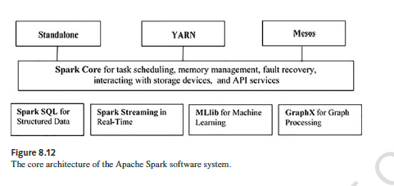
Notes:
Cloud applications are the key global opportunity for developers during next four years
2009: $8.5 billion
2013: $16.8 billion

Slide 63
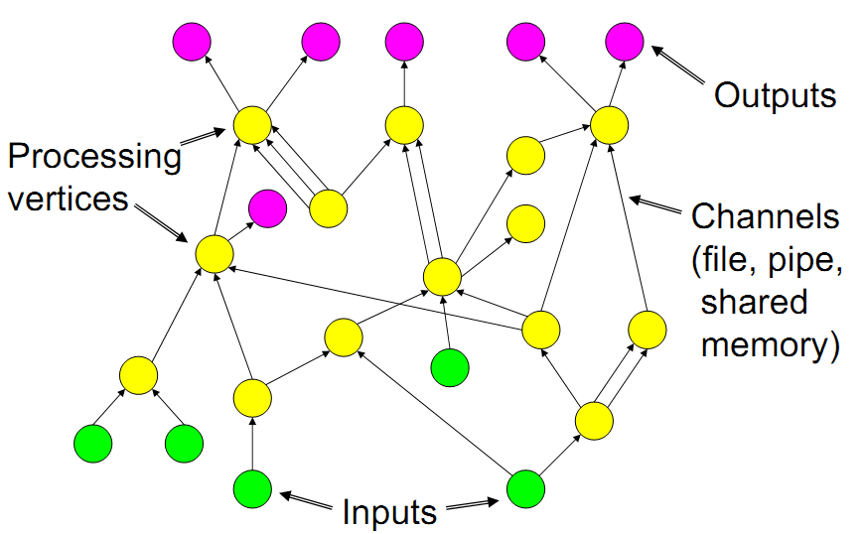
Dryad Control and Dataflow using Directed Acyclic Graph (DAG) in DryadLYNQ
Notes:
Cloud applications are the key global opportunity for developers during next four years
2009: $8.5 billion
2013: $16.8 billion

Slide 64
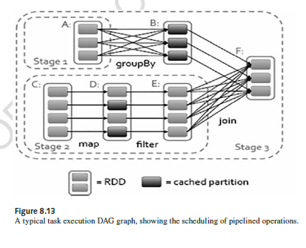
Notes:
Cloud applications are the key global opportunity for developers during next four years
2009: $8.5 billion
2013: $16.8 billion

Slide 65
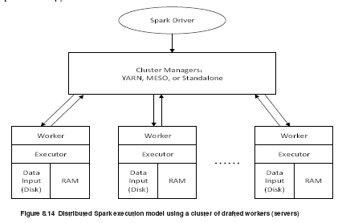
Distributed Spark Model for In-Memory Computations
Notes:
Cloud applications are the key global opportunity for developers during next four years
2009: $8.5 billion
2013: $16.8 billion

Slide 66
The Core Concepts of Spark
Spark core contains components for
Task scheduling
Memory management
Fault recovery
Interacting with storage systems
Many APIs
Spark’s programming abstraction is enabled by RDD (Resilient Distributed Datasets), defined by many APIs for building and manipulating large collection of data items

Slide 67
Core Concepts of Spark (cont’d)
Spark SQL deals with structured data
Spark Streaming handles live streams of data
Mllib library contains common machine learning functionality
GraphX for manuipulating social network graphs
Spark’s Cluster Manager can run with
Hadoop YARN
Apache Mesos
Spark’s own Standalone Scheduler

Slide 68
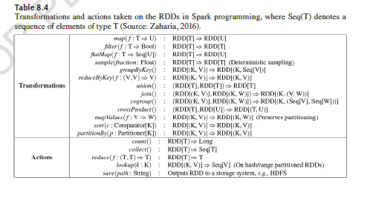
Notes:
Cloud applications are the key global opportunity for developers during next four years
2009: $8.5 billion
2013: $16.8 billion

Slide 69
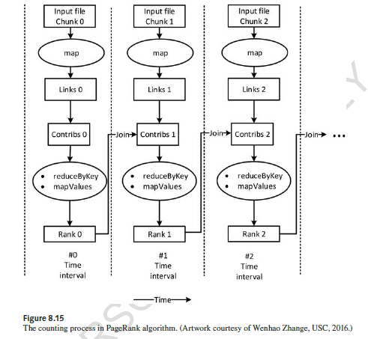
Notes:
Cloud applications are the key global opportunity for developers during next four years
2009: $8.5 billion
2013: $16.8 billion

Slide 70
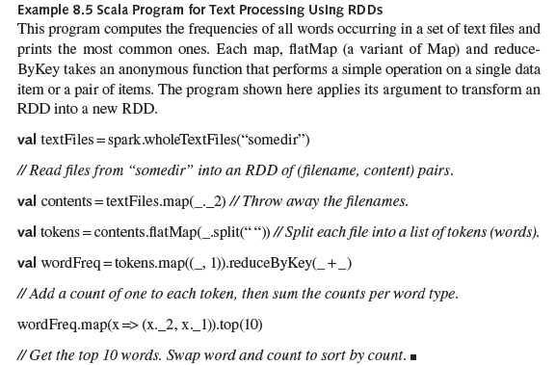
Notes:
Cloud applications are the key global opportunity for developers during next four years
2009: $8.5 billion
2013: $16.8 billion

Slide 71
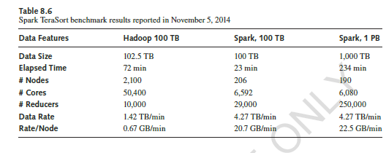
Notes:
Cloud applications are the key global opportunity for developers during next four years
2009: $8.5 billion
2013: $16.8 billion

Slide 72
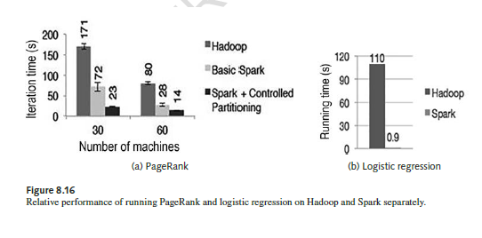
Notes:
Cloud applications are the key global opportunity for developers during next four years
2009: $8.5 billion
2013: $16.8 billion

Slide 73
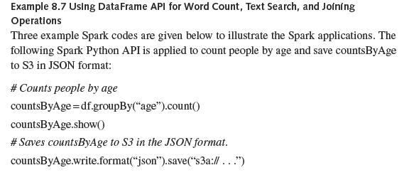
Notes:
Cloud applications are the key global opportunity for developers during next four years
2009: $8.5 billion
2013: $16.8 billion

Slide 74
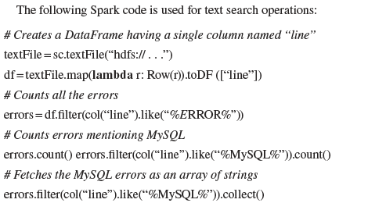
Notes:
Cloud applications are the key global opportunity for developers during next four years
2009: $8.5 billion
2013: $16.8 billion

Slide 75
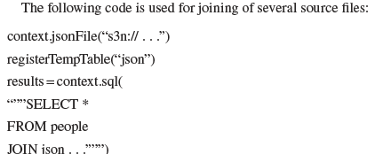
Notes:
Cloud applications are the key global opportunity for developers during next four years
2009: $8.5 billion
2013: $16.8 billion

Slide 76
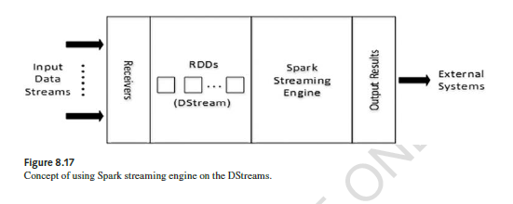
Spark Streaming Operations
Input Sources: Core and multiple sources
Output Operations
Data Transformations (Stateless vs. Stateful)
Fault Tolerant (FT) Operations
Streaming User Interface

Slide 77
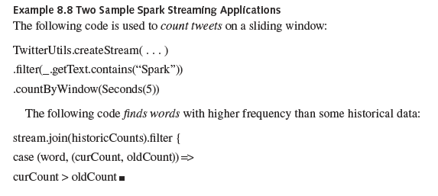
Notes:
Cloud applications are the key global opportunity for developers during next four years
2009: $8.5 billion
2013: $16.8 billion

Slide 78
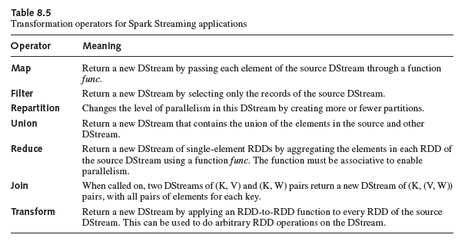
Notes:
Cloud applications are the key global opportunity for developers during next four years
2009: $8.5 billion
2013: $16.8 billion

Slide 79
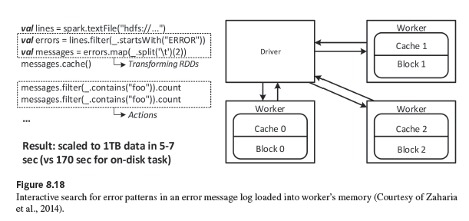
A Typical Spark Application

Slide 80
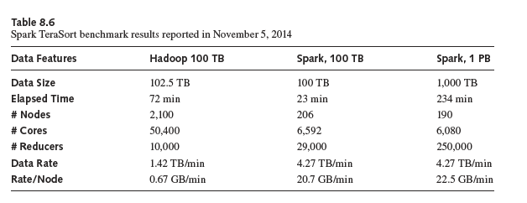
Notes:
Cloud applications are the key global opportunity for developers during next four years
2009: $8.5 billion
2013: $16.8 billion

Slide 81
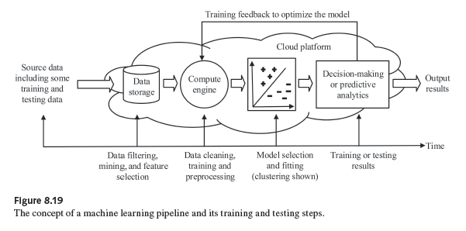
Notes:
Cloud applications are the key global opportunity for developers during next four years
2009: $8.5 billion
2013: $16.8 billion

Slide 82
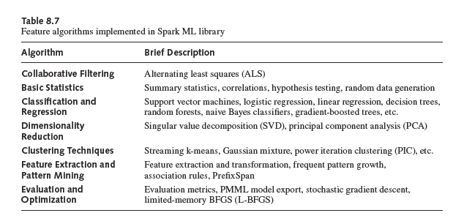
Notes:
Cloud applications are the key global opportunity for developers during next four years
2009: $8.5 billion
2013: $16.8 billion

Slide 83
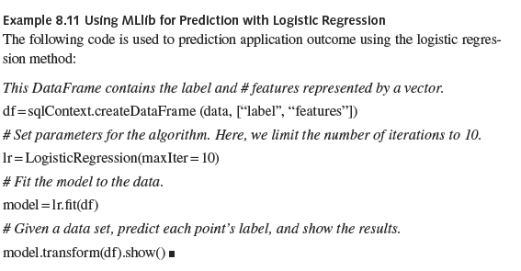
Notes:
Cloud applications are the key global opportunity for developers during next four years
2009: $8.5 billion
2013: $16.8 billion

Slide 84
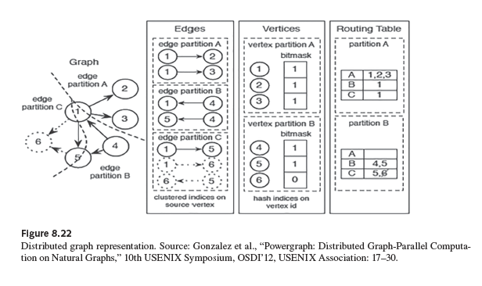
Notes:
Cloud applications are the key global opportunity for developers during next four years
2009: $8.5 billion
2013: $16.8 billion

Slide 85
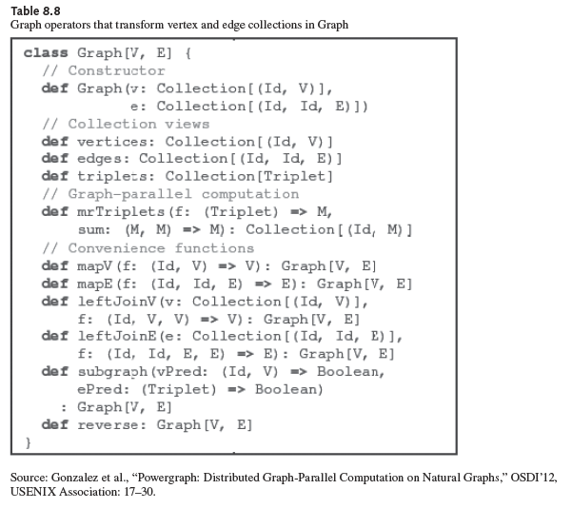
Notes:
Cloud applications are the key global opportunity for developers during next four years
2009: $8.5 billion
2013: $16.8 billion

Slide 86
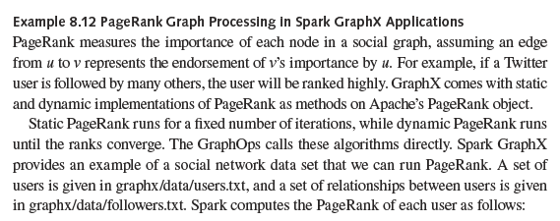
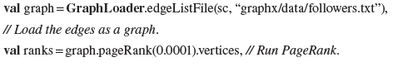
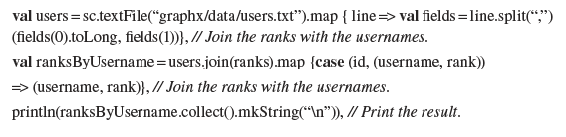

Slide 87



Slide 88



Slide 89

Scala PageRank Example (Cont’d)

Slide 90

Notes:
Cloud applications are the key global opportunity for developers during next four years
2009: $8.5 billion
2013: $16.8 billion

Slide 91


Spark X Programming Example

Slide 92

World Record on TeraSort Benchmark Competition in 2014

Slide 93

Notes:
Cloud applications are the key global opportunity for developers during next four years
2009: $8.5 billion
2013: $16.8 billion

Slide 94

Advances in HLL for Clouds
Notes:
Cloud applications are the key global opportunity for developers during next four years
2009: $8.5 billion
2013: $16.8 billion

Slide 95














Cloud Services: Constraints, Cost and Productivity
Constraints in the App Model
Less Constrained
More Constrained
Horizontal Software
Horizontal
Service
Vertical
Service
Compute & Storage
Salesforce
Cost
Less Automation
More Automation
Less
More
Productivity (assuming a match of app to programming model)

Slide 96
Concluding Remarks
Google’s MapReduce enabled fast search engines in the past two decades
Apache Hadoop made it possible for big-data processing on large server clusters or on clouds in the past decade.
Since 2009, Berkeley Spark frees up many constraints in MapReduce and Hadoop programming for general-purpose static or streaming big-data applications
To become a competent computer professional or data scientist today, you must master your MapReduce, Hadoop, and Spark programming skills
There is no short cut in learning these skills unless you push yourself to use them in real-life apps. Do not escape from the practice opportunities in the Team Project

